Slide 1
Footprinting, Reconnaissance and System Hacking
Lecture 9

Slide 2
System Hacking
System hacking is defined as the compromise between computer systems and software to access the target computer and steal or misuse their sensitive information.
The malware and the attacker identify and exploit the vulnerability of the computer system to gain unauthorized access.

Slide 3
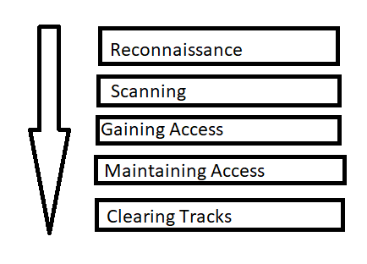
Phases of System Hacking
Reconnaissance/Footprinting
Scanning
Gaining access
Maintaining access
Covering tracks

Slide 4
Reconnaissance/Footprinting
Footprinting
It is called as Footprinting and information gathering Phase.
Attacker collect as much information as possible about the target.
Trying to collect the information about the target without directly accessing the target.
Footprinting involves passive data gathering techniques, such as searching public websites, social media platforms, and online forums for information about the target. This information can include company details, employee names, email addresses, and even technical specifications of the systems they use.

Slide 5
Reconnaissance/Footprinting
Example of Footprinting :
Open Source Intelligence (OSINT): Gathering information from publicly available sources like websites, blogs, news articles, and social media platforms.
Network Scanning: Identifying active network devices, their IP addresses, and open ports to gather information about the target system and its structure.
DNS Enumeration: Collecting information about the target’s domain name system (DNS), including subdomains and associated IP addresses.
Whois Lookups: Understanding the ownership and registration information of the target domain. etc.

Slide 6
Reconnaissance/Footprinting
Reconnaissance :
Reconnaissance involves actively probing the target’s systems, networks, and infrastructure to uncover vulnerabilities. This can include scanning for open ports, identifying weak passwords, and exploring network configurations to discover potential points of attack.

Slide 7
Example of Reconnaissance
Port Scanning: Examining the target system for open ports and services, which can provide insights into potential vulnerabilities.
Vulnerability Scanning: Identifying known vulnerabilities in the target’s systems and software versions to exploit them.
Packet Sniffing: Intercepting network traffic to capture and analyze data packets, searching for sensitive information.
Social Engineering: Manipulating individuals within the target organization to gain unauthorized access to systems or obtain sensitive information. etc.

Slide 8
Difference Between Footprinting and Reconnaissance
While Footprinting and Reconnaissance both involve gathering information, there are some fundamental differences between the two:
1. Methodology: Footprinting is a passive and non-intrusive technique that focuses on information gathering from publicly available sources, while Reconnaissance involves active probing and scanning of the target’s systems.
2. Objective: Footprinting aims to understand the target’s infrastructure and vulnerabilities, whereas Reconnaissance seeks to exploit identified weaknesses and gain unauthorized access to the system.

Slide 9
Difference Between Footprinting and Reconnaissance
3. Risk Level: Footprinting carries a lower risk as it involves collecting information without interacting with the target system. In contrast, Reconnaissance is inherently riskier as it involves actively probing and interacting with the target system, potentially leaving traces and alerts.
4. Legal Considerations: While Footprinting may be legal and involve only publicly available information, Reconnaissance activities often breach legal boundaries and may result in severe consequences if unauthorized access is gained.

Slide 10
2. Scanning
Scanning is a process in which we scan target or targeted system for information gathering.
Three types of scanning are involved:
Port scanning: This phase involves scanning the target for the information like open ports, Live systems, various services running on the host.
Network Mapping: Finding the topology of network, routers, firewalls servers if any, and host information and drawing a network diagram with the available information. This map may serve as a valuable piece of information throughout the hacking process.
Vulnerability Scanning: Checking the target for weaknesses or vulnerabilities which can be exploited. Usually done with help of automated tools

Slide 11
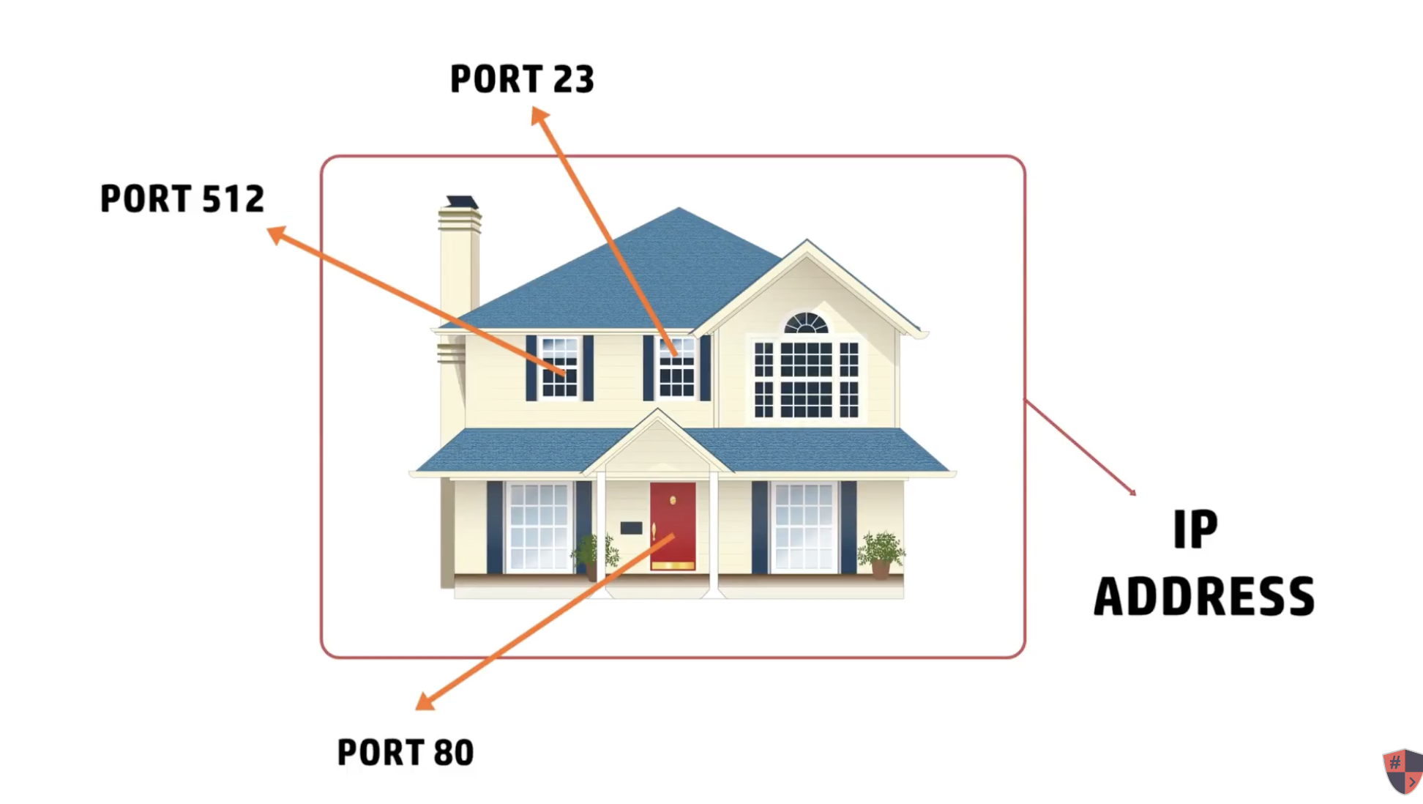
Port Scanning
As the name suggests, Port Scanning is a process used to find out active ports on the network. A Port Scanner sends client requests to the range of ports on the target network and then saves the details about the ports that send a response back. This is how active ports are found.

Slide 12
Port Scanning Techniques
Port scanning techniques are further categorized as described below. This categorization is based on the type of protocol used for communication in the network.
TCP Scanning:
Open TCP Scanning Methods
TCP Connect/Full Open Scan
Stealth TCP Scanning Methods
Half-open Scan
Inverse TCP Flag Scan
Xmas Scan
FIN Scan
NULL Scan
Maimon Scan
ACK Flag Probe Scan
TTL-Based Scan
Window Scan
Third Party and Spoofed TCP Scanning Methods
IDLE/IP ID Header Scan
UDP Scanning:
UDP Scanning
SCTP Scanning:
SCTP INIT Scanning
SCTP COOKIE/ECHO Scanning
SSDP Scanning:
SSDP and List Scanning
IPv6 Scanning:
IPv6 Scanning

Slide 13
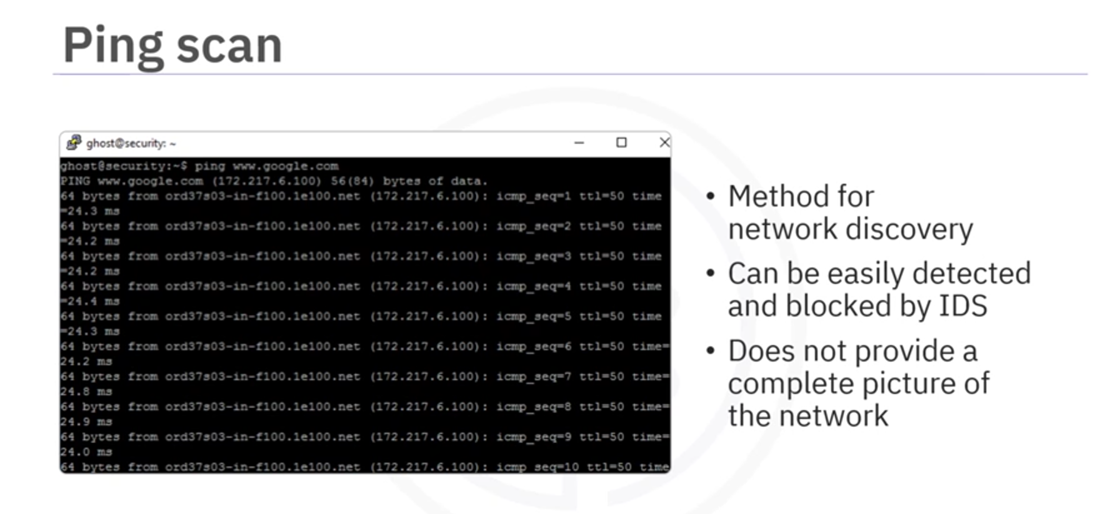
Port Scanning Techniques (Ping Scan)

Slide 14
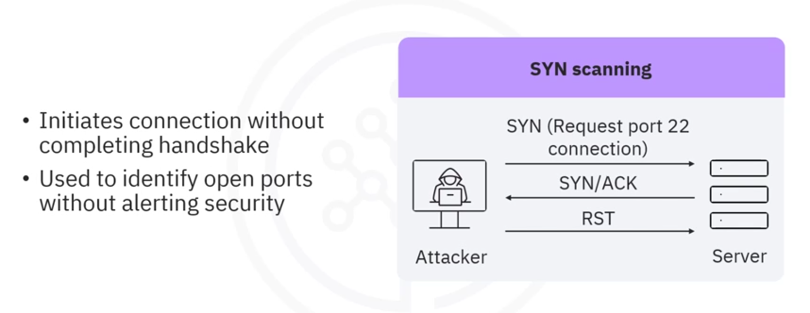
Port Scanning Techniques (SYN Scan)

Slide 15
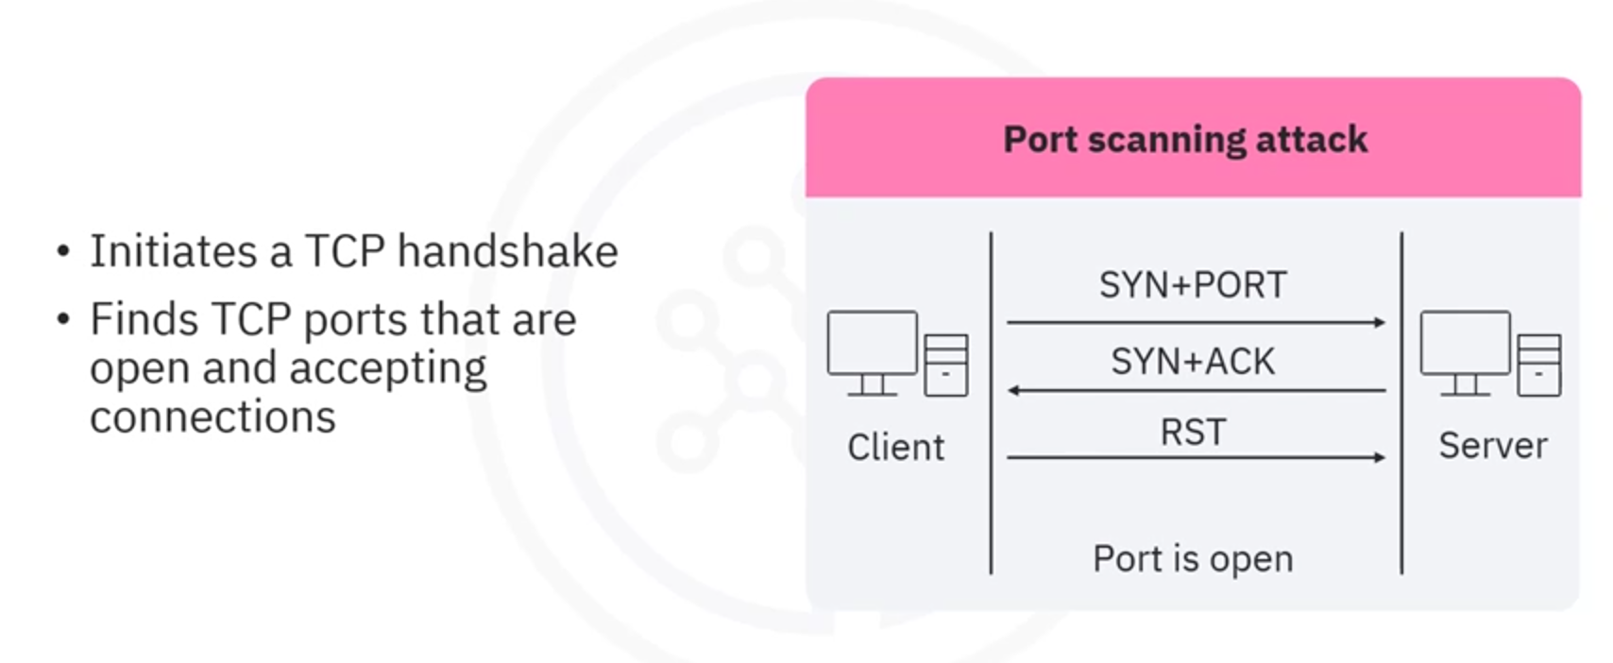
Port Scanning Techniques (TCP Connect Scan)

Slide 16
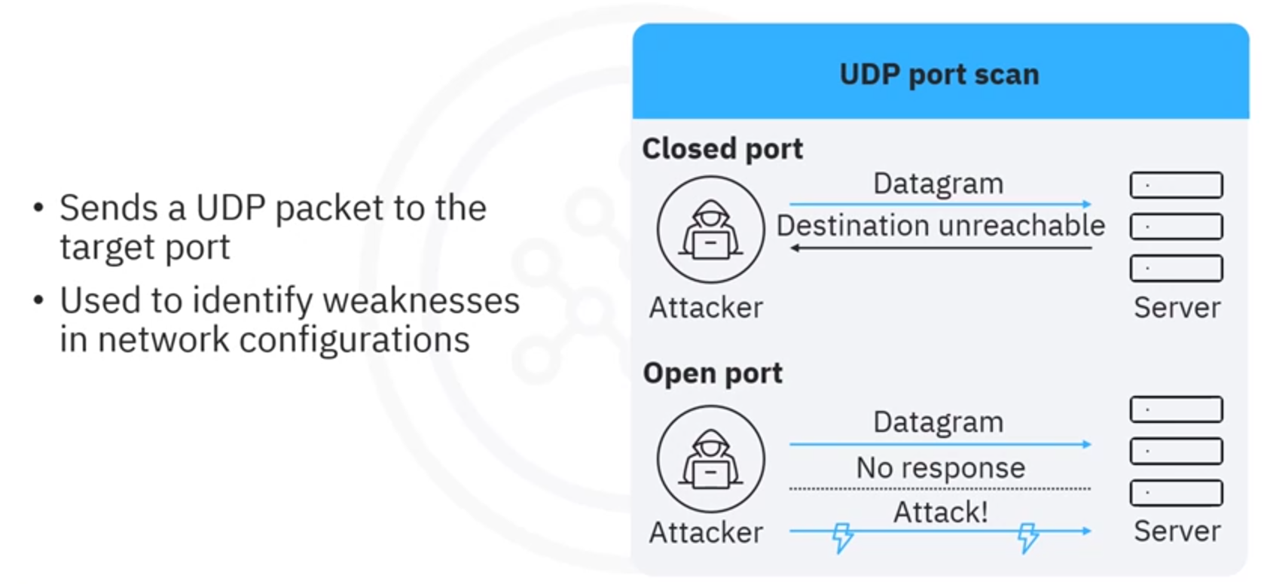
Port Scanning Techniques (UDP Scan)

Slide 17

Port Scanning Techniques (Stealth Scan)

Slide 18
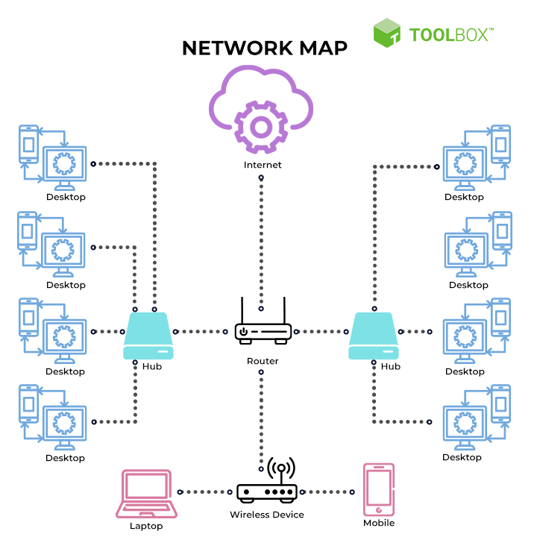
Network Mapping
Network mapping is the process of discovering all entities linked to a network. Network mapping solutions visualize physical and virtual networks and provide in-depth visibility into enterprise IT infrastructure. Organizations use network mapping to simplify network monitoring and swiftly pinpoint network faults with network mapping tools.
Network mapping helps IT teams discover and visualize network connectivity by generating a network map. This map contains network diagrams, flowcharts, device inventories, and topology detection. These visual aids and materials are helpful for numerous purposes, including network security and maintenance.

Slide 19
3. Gaining Access (Exploitation) :
Exploiting Vulnerabilities: This phase involves attempting to exploit the identified vulnerabilities to gain access to the target system. Techniques may include exploiting known vulnerabilities in software, social engineering attacks, and bypassing authentication mechanisms.
Privilege Escalation: Once initial access is gained, the ethical hacker attempts to gain higher-level privileges (e.g., from a standard user to administrator) to gain deeper access to the system.

Slide 20
4. Maintaining Access
After successfully gaining access and escalating privileges to the target system, attackers ensure that high levels of access are maintained to perform malicious activities such as executing malicious applications and stealing, hiding, or tampering with sensitive system files. Ensure continued access by creating backdoors or installing persistent tools.

Slide 21
5. Covering Tracks
No thief wants to get caught. An intelligent hacker always clears all evidence so that in the later point of time, no one will find any traces leading to him

Slide 22
Example System Hacking (Linux)
Imaginate we have a website https://test.daffodilvarsity.edu.bd and behind it a Linux system is running. Our goal is to gain unauthorize assess to this system. Let’s move forward with the System Hacking Process.

Slide 23
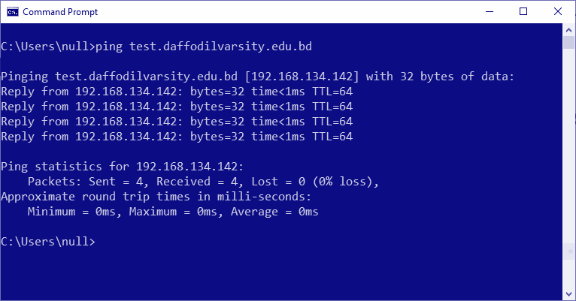
Reconnaissance:
Let’s ping the domain name to find out the IP address of the server behind the domain.

Slide 24
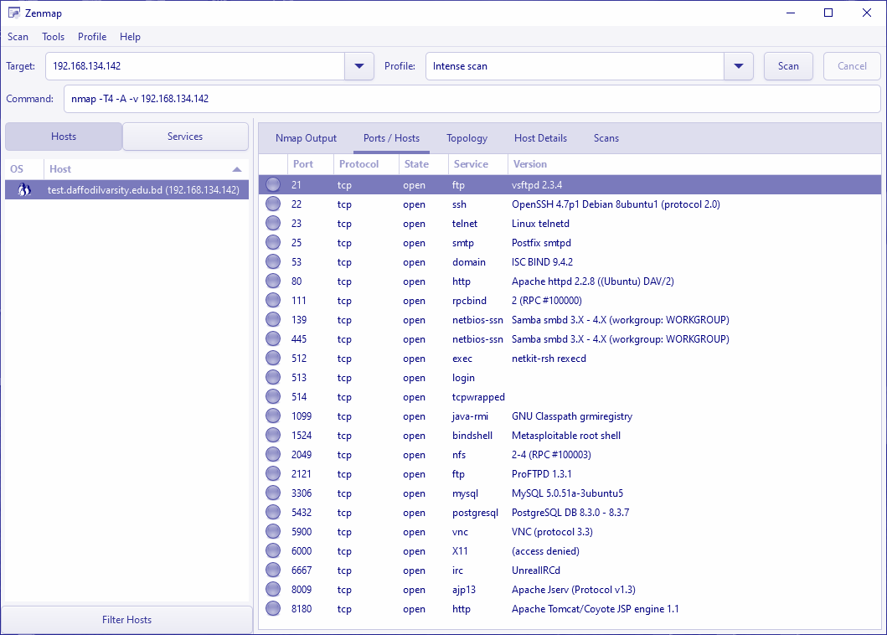
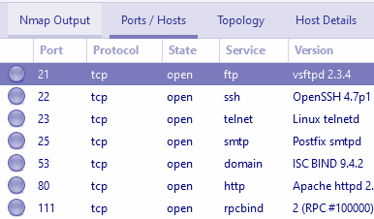
Scanning and Enumeration:
Scan the IP (192.168.134.142) with a port scanner. We are using Zenmap to find out open ports on the server.

Slide 25
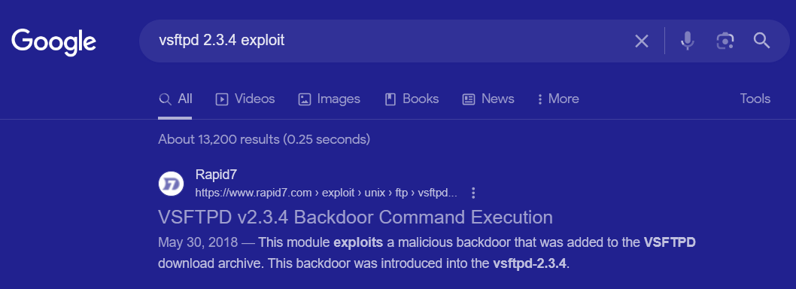
Vulnerability Analysis
Search internet to find out is there any common vulnerability already exposed or not. In this case we found a vulnerability and exploit of this version of FTP software currently this Linux system is using.

Slide 26
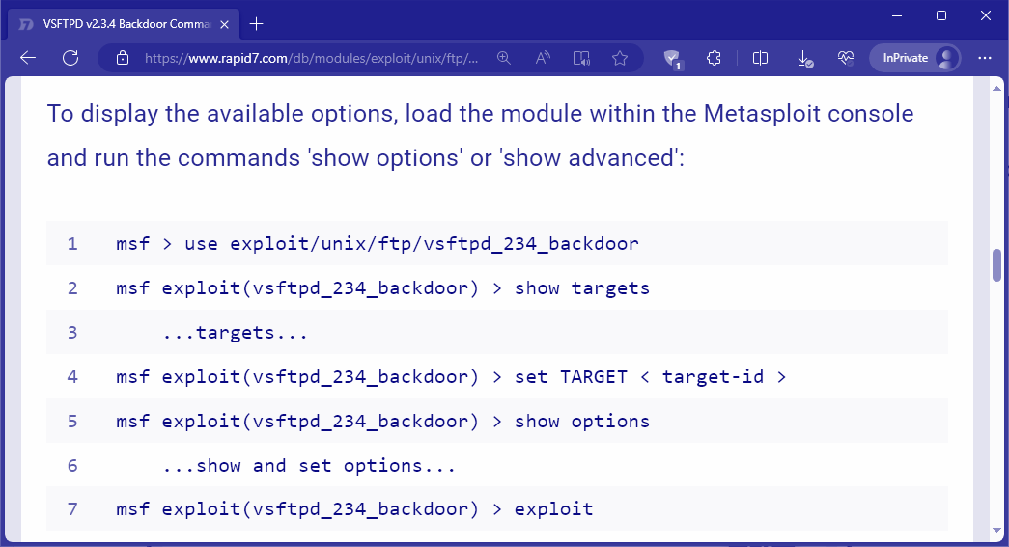
Gaining Access
We read the exploit details of rapid7. The exploit is based on Metasploit Framework (A set of exploitations tools) require a
https://www.rapid7.com/db/modules/exploit/unix/ftp/vsftpd_234_backdoor/

Slide 27
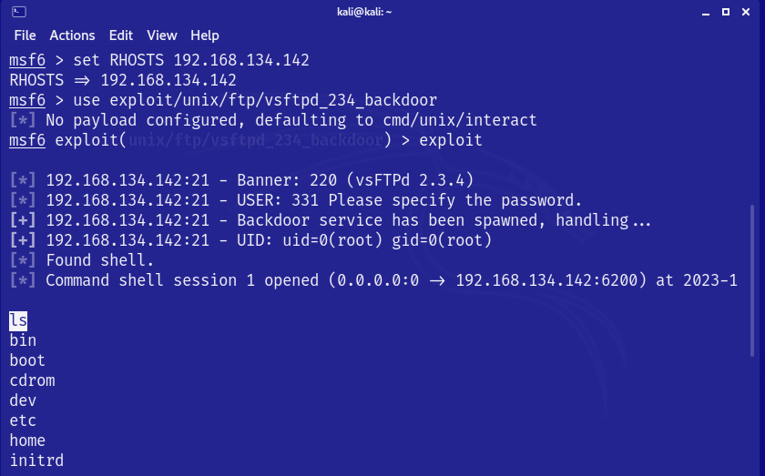
Gaining Access (Exploit)
Using Metasploit to gain unauthorized access (Access Gained)

Slide 28
Now we can process
Maintaining Access, Privilege Escalation, Covering Tracks, Data Collection, Malicious Actions and Persistence

Slide 29
Thanks!

